Slide 1

Spendify
This Project & Presentation is for partial fulfilment of
Front End Engineering - II(22CS004)
Submitted By
CSE-G30/T07
Kushagra Juneja (2210990533)
Keshav Gupta (2210990505)
Lisha Goel (2210990542)
Presented To
Mr. Vikas Patel
Department of Computer Science and Engineering
Chitkara University, Punjab

Slide 2
TABLE OF CONTENT
INTRODUCTION
PROBLEM STATEMENT
TECHNICAL DETAILS
KEY FEATURES
PROJECT HIGHLIGHTS
FUTURE SCOPE
CONCLUSION
BIBLIOGRAPHY

Slide 3

PROJECT DETAILS
3
Spendify

Slide 4
INTRODUCTION
“Spendify” is an expense tracker website designed to help users manage their daily expenditure more efficiently.
The website provides a user-friendly interface for users to manage all aspects of their expenditure, including categorizing the spent money and knowing the left balance.
Spendify's primary features include categorizing the spent money in a tabular form, enabling users to set budget limits and making money handling easier.

Slide 5
Problem statement
Tracking your expenditure with the hassle of manual data entry can be overwhelming and really tiring.
An expense tracking website, where managing your finances becomes a seamless and effortless experience, designed using HTML, CSS, and JavaScript, with features such as expense entry, expense categorization and budgeting
This website will help you control your finances and manage your money from the palm of your hand.

Slide 6
Technical Details
HTML : The Hypertext Markup Language or HTML is standard markup language for documents designed to be displayed in a web browser.
CSS : CSS or cascading style sheets is used for styling and formatting HTML documents. It is used to define styles for HTML elements such as fonts, colors, spacing and layout.
JavaScript : JavaScript is a programming language used to add interactivity and functionality to websites. It is commonly used to create dynamic effects, responsive and interactive web pages.
Visual Studio Code : Visual studio code is a free and open-source code editor developed by Microsoft and is designed for building and debugging web and cloud applications.

Slide 7
Key features
EXPENSE TRACKING : “Spendify” is an expense tracking website. It is an online platform designed to help users manage their expenditure more efficiently.
ACCESSIBILITY : This expense tracking website, Spendify, provides users with a comprehensive toolset to help them manage their finances.
EFFICIENT : Very few resources are required to store and run the webpage.
EASY TO USE : The website is typically accessed through a web browser and provides a user-friendly interface for users to manage all their expenditure, from budgeting to categorizing expenses.
FREE TO USE : The Spendify webpage is completely free to use and can be used by anyone for any purpose (household / professional/ Business etc.)

Slide 8
project highlights
Effortless Expense Tracking: “Spendify" effortlessly tracks your daily expenses by manually entering transactions.
Smart Budget Management: “Spendify” can be utilized to set, monitor, and manage your budgets effectively.
Expense Categorization: “Spendify" allows users to categorize expenses to gain insights into spending patterns.

Slide 9
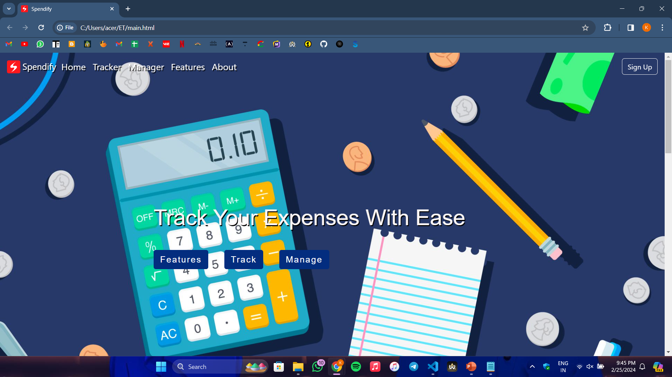
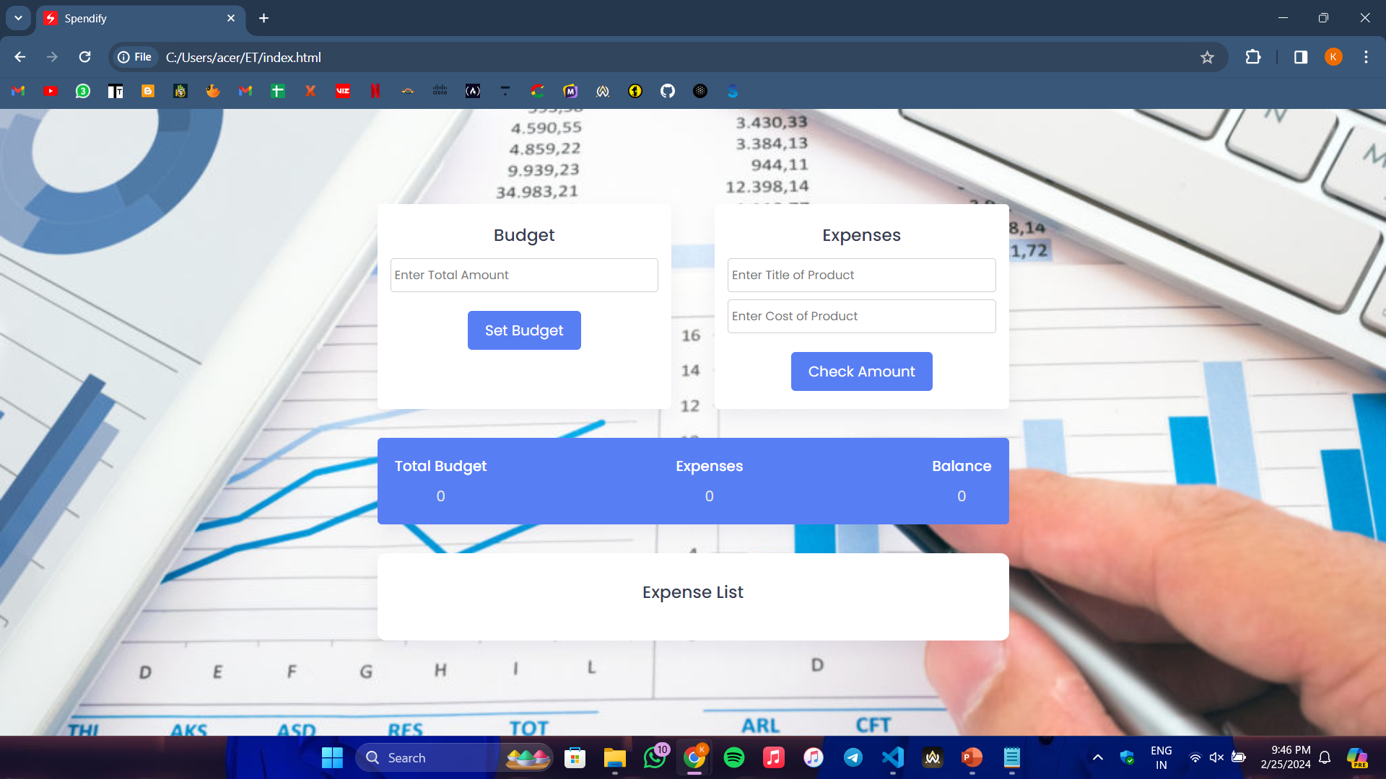
Output

Slide 10
CONCLUSION With future scope
Multi-user login capabilities, allowing friends or business partners to collaborate on expense tracking.
Integration of a bill-splitting feature.
Enhance the visualization of financial data by introducing expenditure graphs.
Improve the categorization system by allowing users to categorize expenses based on specific date ranges.
Developing a mobile application.

Slide 11
BIBLIOGRAPHY
https://en.wikipedia.org/wiki/HTML
https://www.w3schools.com/html/default.asp

Slide 12
THANK YOU
From :-
Kushagra Juneja (2210990533)
Keshav Gupta (2210990505)
Lisha Goel (2210990542)

